Slide 1



Anatomía de una App .NET MAUI
Javier Suárez
Software Engineer, Microsoft
@jsuarezruiz
/JavierSuarezRuiz

Slide 2
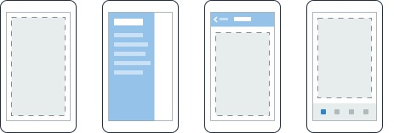
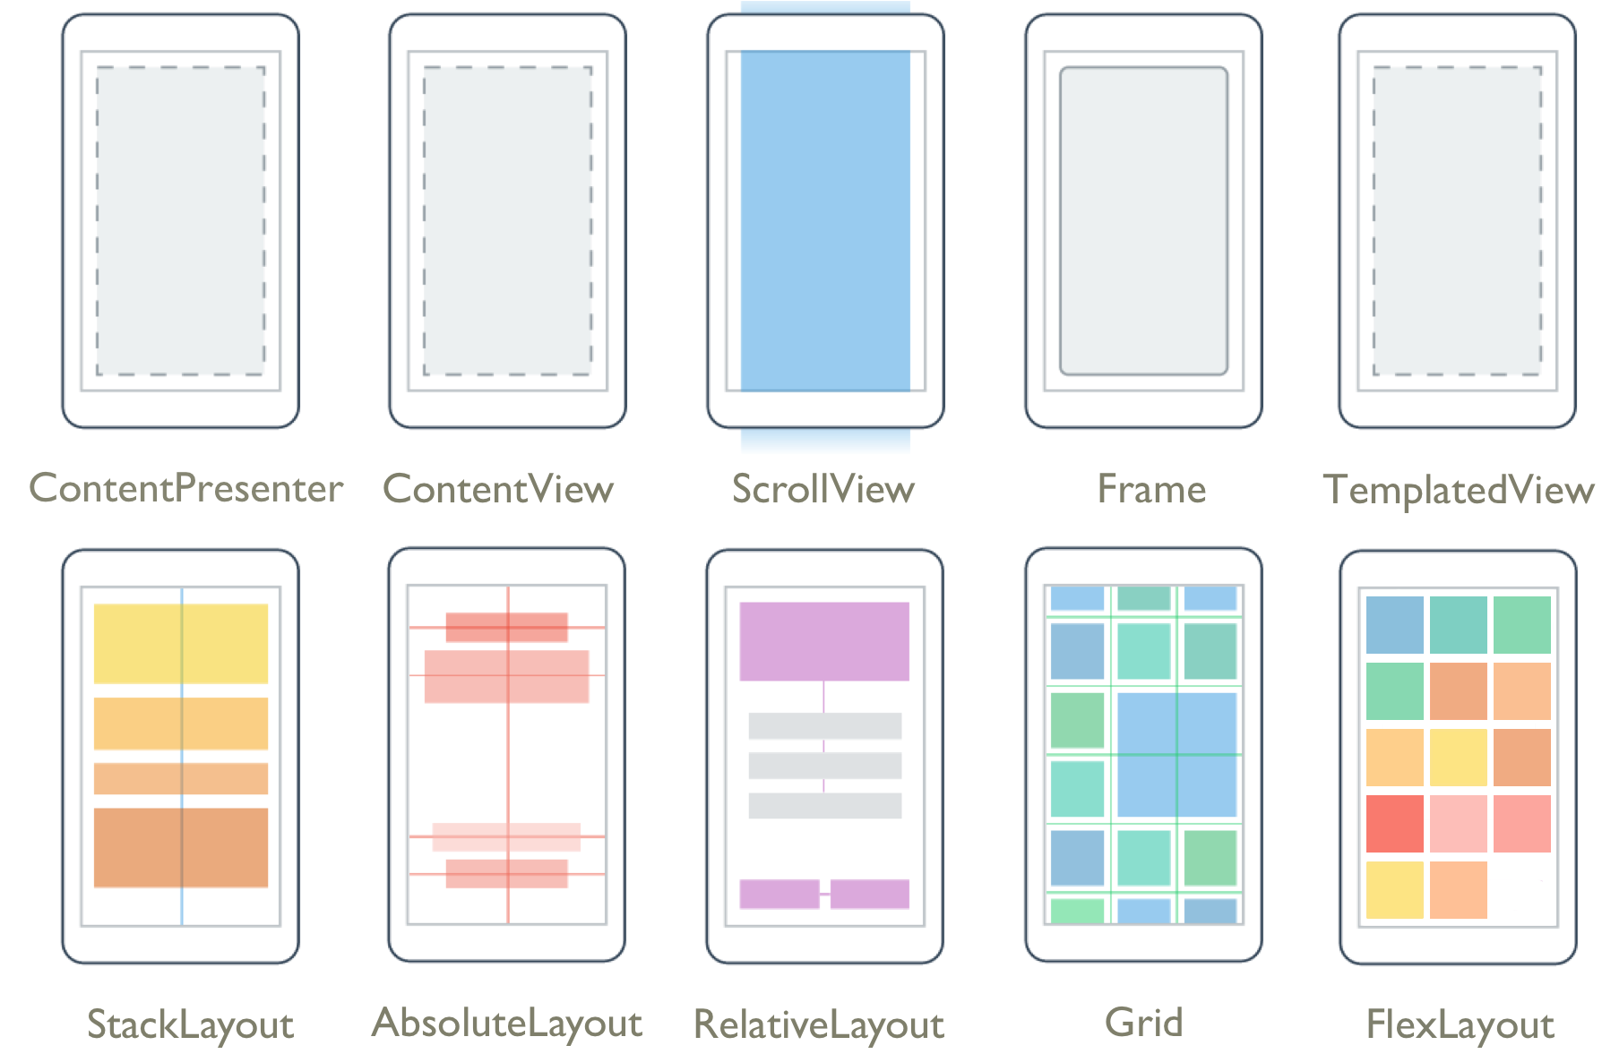
Layouts
Páginas
Content
Flyout
Navigation
Tabbed

Slide 3
Controles
CarouselView
CollectionView
ListView
Picker
TableView
IndicatorView
ProgressBar
ActivityIndicator
Editor
Entry
CheckBox
DatePicker
Slider
Stepper
Switch
TimePicker
Button
ImageButton
RadioButton
RefreshView
SearchBar
SwipeView
BlazorWebview
Border
BoxView
Frame
GraphicsView
Image
Label
ScrollView

Slide 4
Crear Apps
Page (ContentPage)
Layout (StackLayout)
App
Window
Label
Entry
Label
Entry
Button

Slide 5
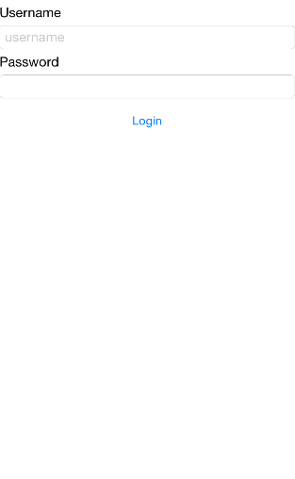
Crear Apps
Page (ContentPage)
Layout (StackLayout)
Label
Entry
Label
Entry
Button

Slide 6
Javier Suárez
Software Engineer, Microsoft
javiersuarezruiz@hotmail.com
javiersuarezruiz.wordpress.com
@jsuarezruiz
/JavierSuarezRuiz

